Slide 1
Optional Practical Training (OPT) Tutorial
What it is and how to apply for it

Slide 2
What is OPT?
OPT is temporary employment in the United States that is directly related to a student’s field of study.
OPT authorization allows students to work for up to 12 months before or after their program completion date.
Eligible students can receive up to 12 months of OPT employment authorization before graduation (pre-completion OPT) and/or after graduation (post-completion OPT).

Slide 3
Types of OPT
Pre-Completion OPT: If you have been enrolled as a student for one full academic year, you may apply for Pre-completion OPT. Pre-Completion OPT is part-time employment before program completion. You may work full time during university breaks. (If you are eligible for CPT, this is a better option than using Pre-Completion OPT).
Post-Completion OPT: This type of OPT is employment after completing your studies. Post-completion OPT may be part-time (at least 20 hours per week) or full time.

Slide 4
Can I apply for OPT?
OPT may be granted to an F-1 student who has been enrolled on a full time basis for one full academic year.
If you used 12 months of pre-completion OPT, you will not be eligible for post-completion OPT. All periods of pre-completion OPT are deducted from the available period of post-completion OPT.
Students are allowed 12 months of OPT per education level (bachelors, masters, doctorate, etc.).
Students in English Language Training programs are not eligible for OPT.
You may apply for OPT beginning 90 days before your program completion date.

Slide 5
Types of Employment
OPT must be a minimum of 20 hours per week in a job that is related to your program of study.
The types of employment allowed during OPT include the following:
Multiple employers
Work for hire
Self-employed business owner
Employment through agency
Paid employment
Unpaid / Volunteer employment
See a full list with descriptions online at https://www.ice.gov/doclib/sevis/pdf/opt_policy_guidance_042010.pdf

Slide 6
Application Process Overview
Complete HIU’s OPT Application Form and send to isp@hiu.edu.
Prepare application materials.
Complete the USCIS Application for Employment Authorization in the ISP office.
Mail the application packet to USCIS.
Receive the Employment Authorization Document (EAD).

Slide 7
Step 1
Submit the completed Application for Optional Practical Training to the ISP office in person or by e-mail at isp@hiu.edu.
Make an appointment to see your DSO in the ISP Office by e-mailing isp@hiu.edu.

Slide 8
Step 2
Prepare the following:
Check or Money Order payable to US Department of Homeland Security = $410
Form I-94: print from https://i94.cbp.dhs.gov/I94/#/home
A copy of your previous EAD card(s) (if you have one)
A copy of your passport (photo page and visa page)
Two recent passport-style photos (follow strict OPT guidelines)
Copies of all previously issued I-20s signed by DSO

Slide 9
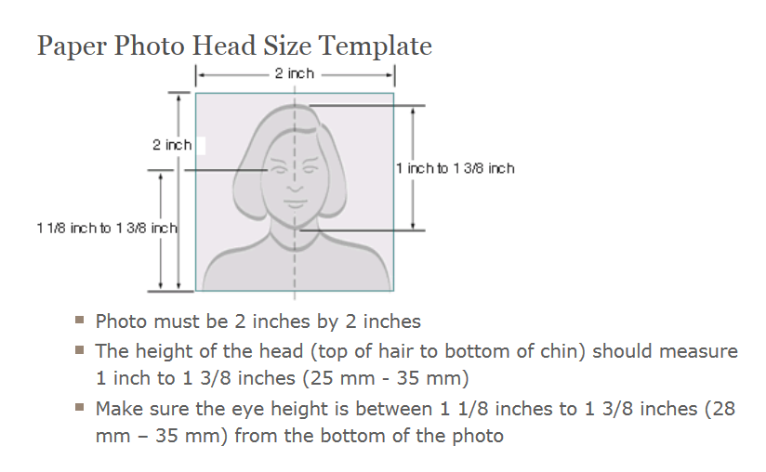
OPT Photo Guidelines
You must submit two identical color photographs of yourself taken within 30 days of filing your application. The photos must have a white to off-white background, be printed on thin paper with a glossy finish, and be unmounted and unretouched.

Slide 10
When should I apply for OPT?
90 days before program end date
This is the earliest that you can apply for OPT.
Program End Date
This is last day of your last semester in the program.
60 days after program end date
This is the final deadline for OPT applications to be received by USCIS.
Apply to USCIS up to 90 days before program end date.
OPT must begin within 60 days of program end date.
USCIS processing time = 3 months average

Slide 11
OPT Application Timeline – Fall Semester
September 15, 2017
This is the earliest you can apply to USCIS for OPT authorization.
December 14, 2017
Last day of fall semester
February 12, 2018
Final deadline for OPT application
Apply to USCIS up to 90 days before program end date.
OPT must begin within 60 days of program end date.
This timeline is based on a program end date of 12/14/2017.
USCIS processing time = 3 months average

Slide 12
OPT Application Timeline – Spring Semester
February 9, 2018
This is the earliest you can apply to USCIS for OPT authorization.
May 10, 2018
Last day of spring semester
July 9, 2018
Final deadline for OPT applications
Apply to USCIS up to 90 days before program end date
OPT must begin within 60 days of program end date
This timeline is based on a program end date of 05/10/2018.
USCIS processing time = 3 months average

Slide 13
OPT Timeline
OPT application received by USCIS.
OPT Start Date
OPT End Date
This date may not be more than 14 months from your program end date.
F-1 status ends
Employment Authorization Document (EAD) received. You may not start working until after you receive your EAD card and your OPT start date is reached, whichever is later.
Period of OPT
You are allowed up to 12 months of OPT. During this time, you are allowed 90 days of unemployment
60 days grace period
USCIS processing time = 3 months average

Slide 14
OPT Timeline: Fall Semester
September 20, 2017
OPT Application received by USCIS
January 15, 2018
OPT Start Date
January 14, 2019
OPT End Date
December 20, 2017
Student receives EAD from USCIS. Student cannot work until OPT start date.
F-1 status ends
December 14, 2017
Program End Date
Period of OPT
You are allowed up to 12 months of OPT. During this time, you are allowed 90 days of unemployment
60 days grace period
This timeline is based on a December 14, 2017 program end date.
USCIS processing time = 3 months average

Slide 15
Travel and Re-Entry During OPT: While Application is Pending
You may reenter the U.S. while your OPT application is pending. However, keep in mind that USCIS may send you a request for evidence while you are away. Also, if USCIS approves your OPT application during your travels, you will be expected to have your EAD with you when you re-enter the United States.
USCIS can only send the EAD to your U.S. address.

Slide 16
Travel and Re-Entry during OPT: After Approval
If you travel during your OPT period, you will need to present your EAD to re-enter the U.S., in addition to your I-20, valid passport and visa, and a letter of employment if you have one.
If you exceed the limits on unemployment while outside the United States, you will not be eligible to re-enter the United States in F-1 status.
Here’s more information on travel and re-entry: https://www.ice.gov/sevis/travel

Slide 17
Additional Resources
General Information on OPT https://studyinthestates.dhs.gov/sevis-help-hub/student-records/fm-student-employment/f-1-optional-practical-training-opt
USCIS Information on OPT https://www.uscis.gov/working-united-states/students-and-exchange-visitors/students-and-employment/optional-practical-training
Travel and Re-Entry https://www.uscis.gov/working-united-states/students-and-exchange-visitors/students-and-employment/optional-practical-training
Link to USCIS Employment Authorization Application https://www.uscis.gov/i-765

